Slide 1
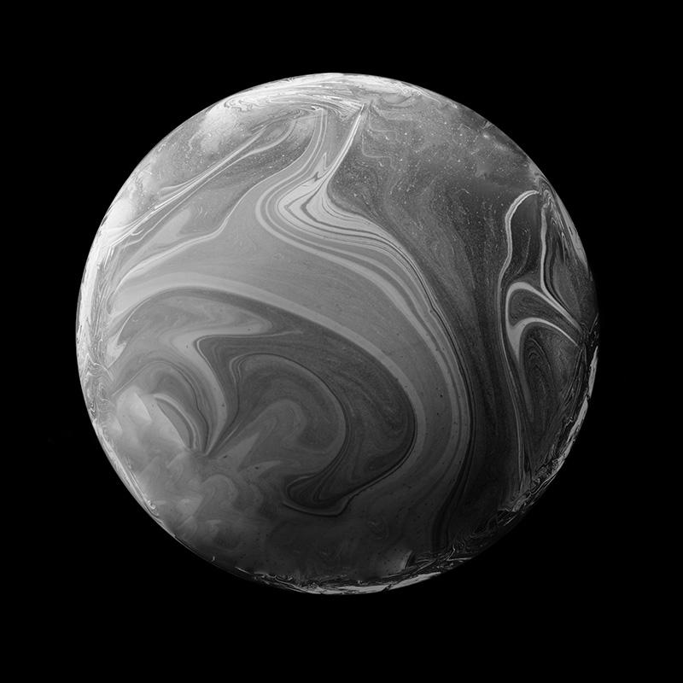

UFO SIGHTINGS IN MEXICO
"Is humanity truly solitary in the vast expanse of the universe, or do extraterrestrial civilizations exist beyond our current reach and understanding?"

Slide 2
UNIDENTIFIED FLYING OBJECT
This analysis aims to identify and classify UFO’s
“Landing” some conclusions about information we find online
Being as objective as possible

Slide 3
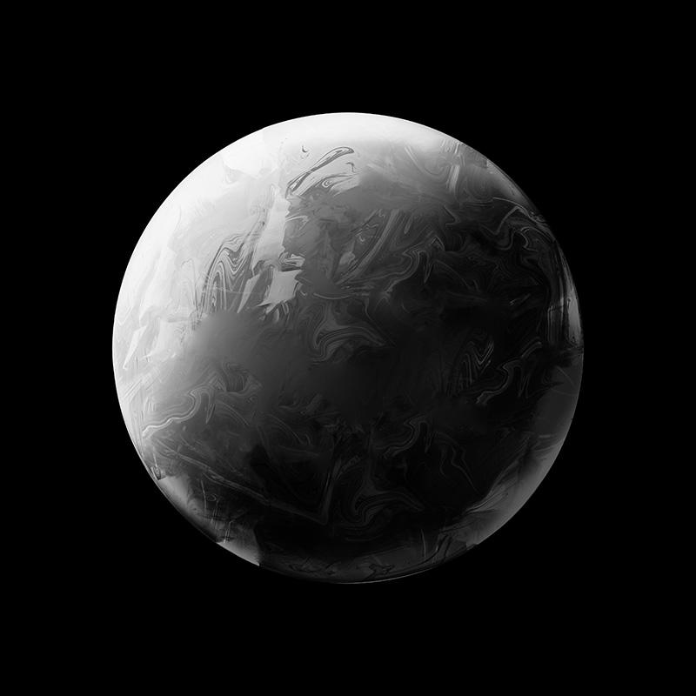
TABLE OF CONTENTS
01
04
02
05
03
Resources
app.py
What was used for cleaning, merging, exporting, reading
Python instructions to create api and deploy WebApp
Web Scraping
In Depth
Building the database
Overview of the directory tree
SQL Database
Reading and utilizing

Slide 4
01
RESOURCES
Splinter and BeautifulSoup for web scraping
FuzzyWuzzy for string matching and comparison
Pandas for data manipulation and analysis
Flask for building a WebApp and API
SQLAlchemy for working with a database from pgAdmin
Leaflet for interactive map generation
D3 for data binding JSON

Slide 5
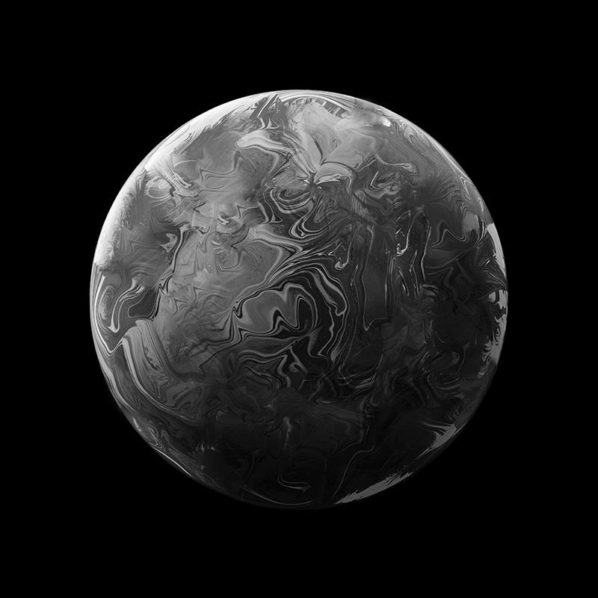
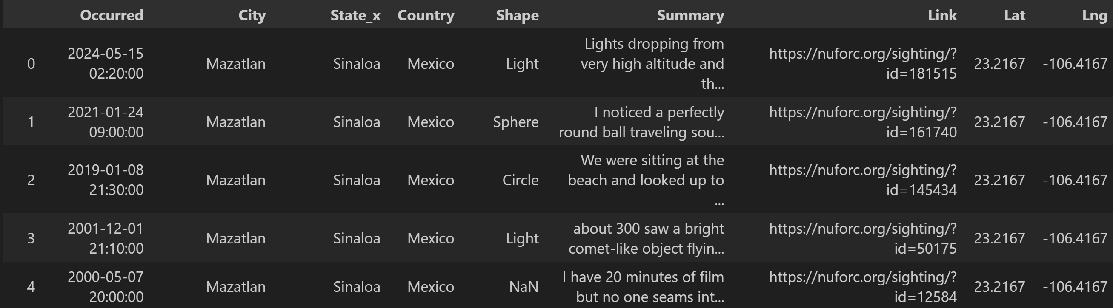
Web Scraping
From the National UFO Reporting Center’s website
www.nuforc.org
Splinter, BeautifulSoup and pandas was used in a Jupyter Notebook to scrape Mexico’s sightings, transforming the data into a dataframe and cleaning it for further analysis.

Slide 6
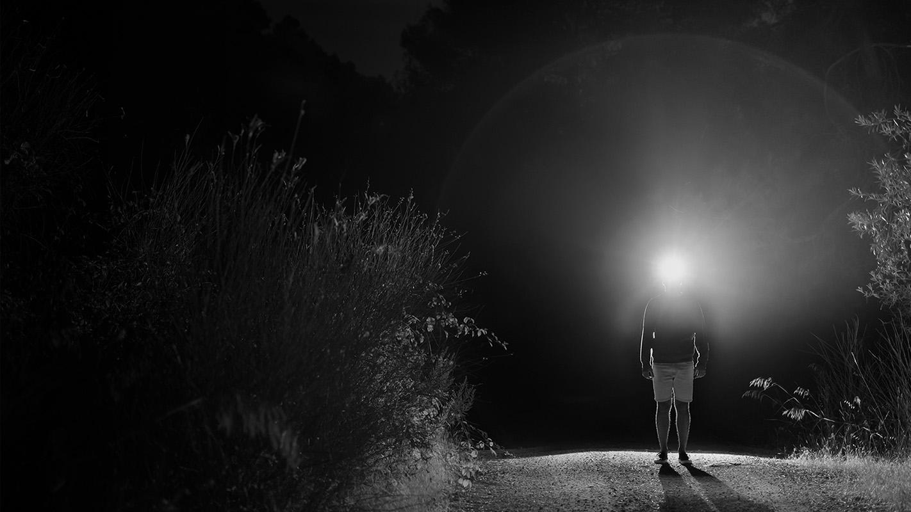
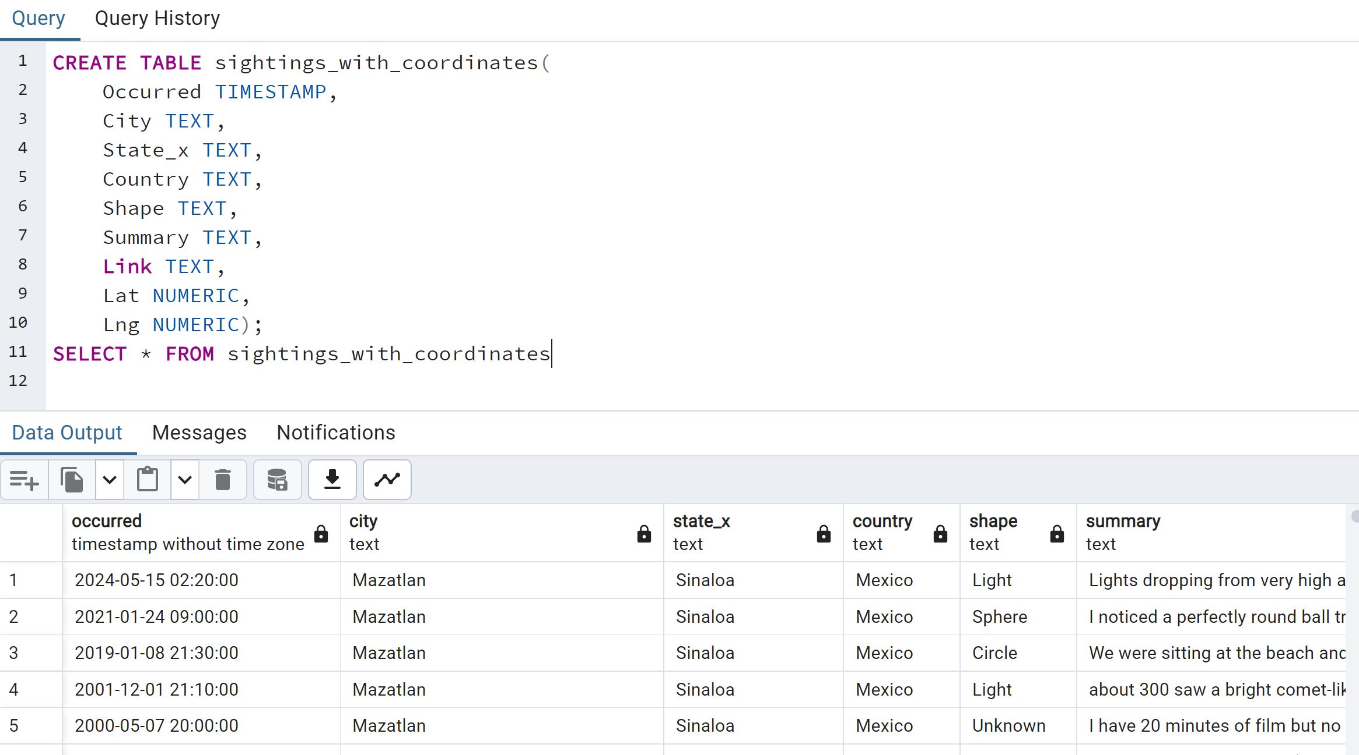
SQL Database
Using pgAdmin, a database was created, importing the csv created previously.

Slide 7
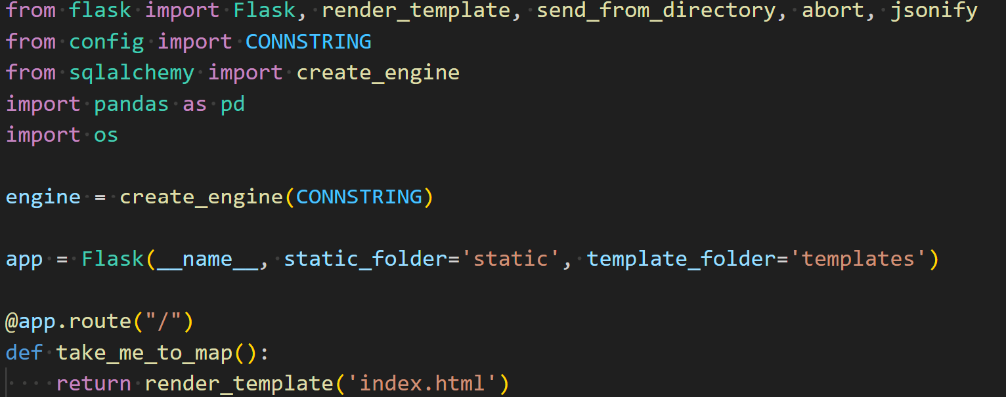
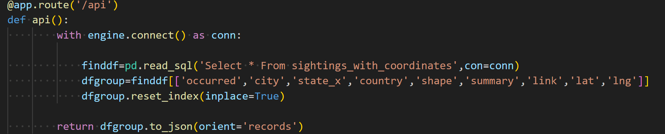
An app.py was created, in which:
Flask, SQLAlchemy and pandas are used to read our pgAdmin database, transform it and deploy our WebApp, which runs our HMTL file.

Slide 8
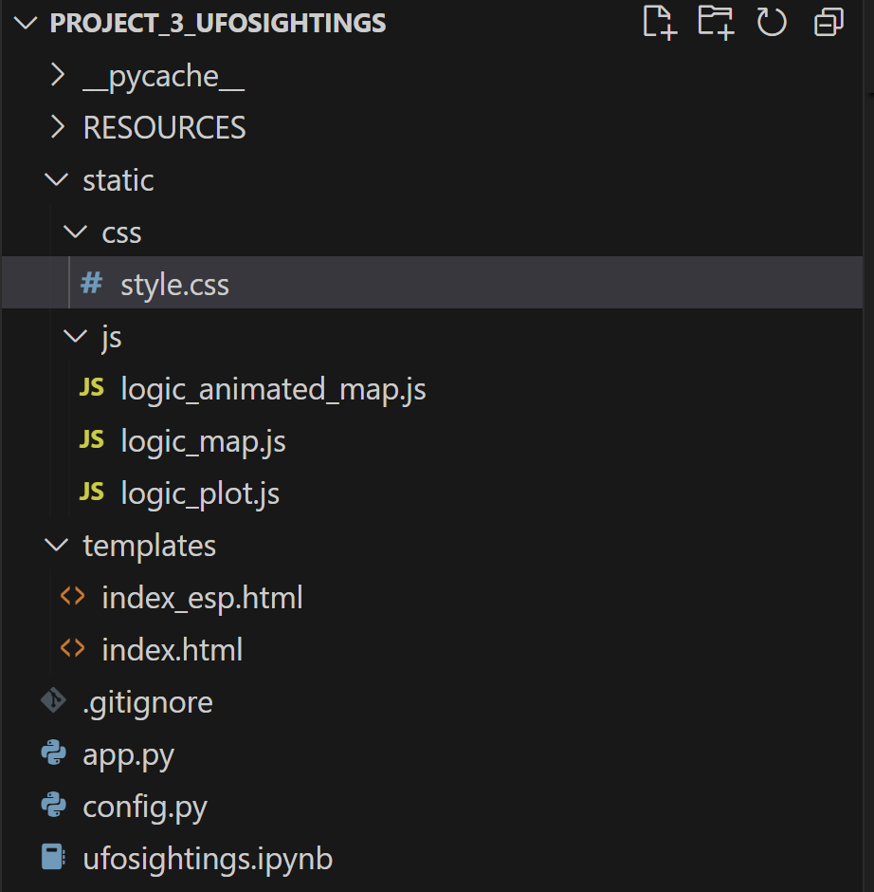
IN DEPTH
Our directory tree looks like this:
Style for the HTML’s
JavaScript files (for maps and charts)
Style for the HTML’s
Python files for creating database, exporting to CSV, reading SQL and outputting as JSON

Slide 9
ANALYSIS INSIGHTS
Even though sightings are reported and documented, many, as evidenced by the attached multimedia, could easily be interpreted as false or fake.
Tijuana, Mexico City, Puerto Vallarta and Cancún have the most reported sightings in Mexico.
The app’s goal is to display UFO sightings information specifically related to Mexico in a fast and interactive way, allowing the user to dive deeper into details such as geographic location and shape.

